Slide 1
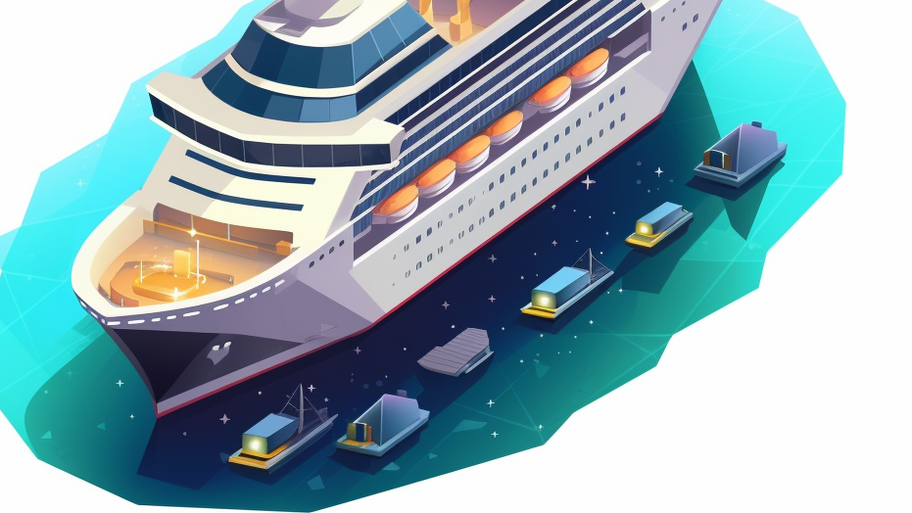
aWei “Cruising with Crypto”
By Mike Hobbs, Antonio Garza, and Ezra Hsiao

Slide 2

Anyone want to go on a cruise ship this summer? Would you like to pay with Crypto? This is possible IF… Implementation? What are the added benefits?

Slide 3
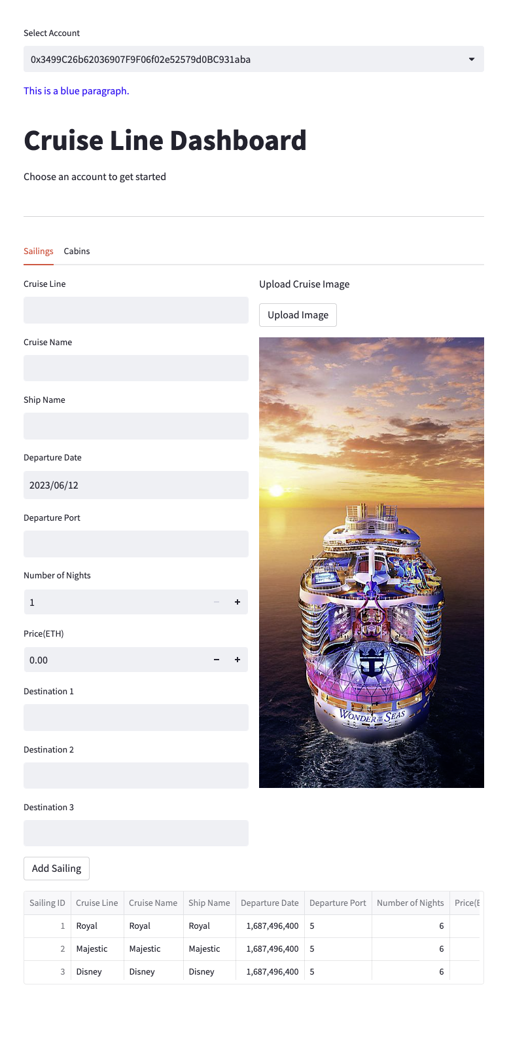
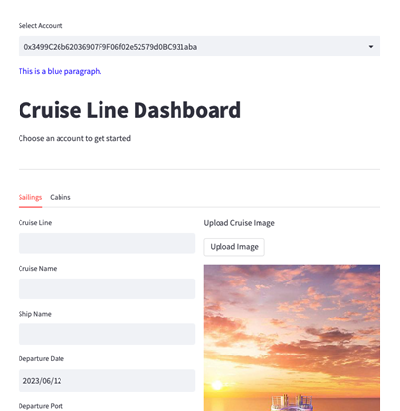

Slide 4
Description
aWei is a web3 platform that allows cruise lines to transparently manage, price, and sell inventory on the Ethereum blockchain. It provides cruise lines with a UI and dashboard that allows them to add mintable inventory to the platform, track and fulfill bookings, and adjust pricing. It also provides them with a customer UI that allows travelers to browse inventory and mint(buy) cabin reservations as NFTs directly from the cruise line. Customers can also easily trade cabins to others via the same UI.

Slide 5
Benefits to cruise line
Increase direct-to-consumer bookings (increases margins by decreasing commissions paid and third party mark ups)
Reduce reliance on online travel operators and other middlemen (inventory management is under direct control of the cruise line)
Cut out significant accounts payable and inventory tracking bloat (everything tracked on chain)
Funds are escrowed on chain and cruise lines are not subject to payment deliquincies and OTA bankruptcies (trustless)
Provides cruise lines with access to the web3 market (reduce advertising expense)
Capture royalties on the resale of cabins on the secondary market
Increased inventory transparency
Gives cruise lines complete control over pricing and eliminates rate parity agreements with OTA's
Receive token rewards for using the platform
Market to past customers more easily by issuing rewards for used NFT holders (on chain rewards program)

Slide 6
Benefits to the consumer
The ability to transfer and sell cabin inventory via a marketplace (no longer subject to cancellation and change policies)
Reduce costs due to supplier cost savings that can be passed to the end user
Status - show off your travel reservations to other members of the community (keepsake NFT)
Keep reservations in a web3 wallet as opposed to carrying physcial documents
Receive token rewards for using the platform (can be used for upgrades, excursions, etc)

Slide 7
Executive summary.
Financial potential:
Cruise Industry Revenue: The global cruise industry has been a significant contributor to the travel and tourism sector. According to Cruise Lines International Association (CLIA), the cruise industry generated over $150 billion in revenue in 2019.
Marketplace:
The Cruise Ship Industry is dominated by three big players, 1. Carninval, 2. Royal Caribbean and 3. Norwegian Cruise. This is a High barrier to entry market, cruises cost $500 million to $1 billion to make. When any of these Cruises implement aWei, $150 billion is not so far away..

Slide 8
Demo
Notes:
How you tested the code was working?

Slide 9
Motivation for development
Mike Hobbs previously was in the travel industry.
After discussing we all signed up for this class to learn abut Crypto so we bravely decided to do our capstone project using solidity.

Slide 10
Challenges
We were not able to utilize all the functions in the solidity contract we wanted to:
The functions involving minting the reservation NFT.
The ability to transfer cabins from one customer to another.
Solidity’s getters and setters.

Slide 11

Project goal
Implement NFT’s into the purchase and sale of cruise ship tickets using the solidity we learned in class, the reason we took this class!
Success!

Slide 12
Directions for Future Development
Immediate:
Work on some of the challenges we had with the functions
Future:
Improve the front-end functionality
Create back-end that is not coded into the contract.
Market to Cruise lines.

Slide 13
Links
https://github.com/GitHobbs/project_3/blob/main/README.md GitHub repo

